Slide 1
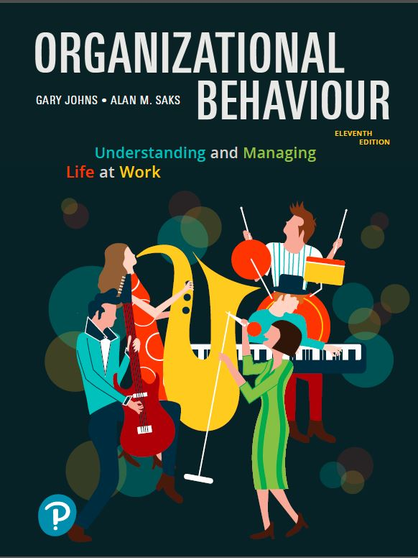
Organizational Behaviour:
Understanding and Managing Life at Work
Eleventh Edition
Chapter 1
Organizational Behaviour and Management
Copyright © 2020 Pearson Canada Inc.

Slide 2
Learning Objectives (1 of 2)
LO1.1 Define organizations and describe their basic characteristics.
LO1.2 Explain the concept of organizational behaviour and describe the goals of the field.
LO1.3 Contrast the classical viewpoint of management with that advocated by the human relations movement.

Slide 3
Learning Objectives (2 of 2)
LO1.4 Describe the contingency approach to management.
LO1.5 Describe the four contemporary management concerns facing organizations and how organizational behaviour can help organizations understand and manage these concerns.

Slide 4
What Are Organizations?
Organizations are social inventions for accomplishing common goals through group effort.
Key characteristics of organizations:
  Social inventions
  Goal accomplishment
  Group effort

Slide 5
Social Inventions
An essential characteristic of organizations is the coordinated presence of people, not things.
The field of organizational behaviour is about understanding people and managing them to work effectively.

Slide 6
Goal Accomplishment
All organizations have goals.
Organizational survival and adaptation to change are important goals.
The field of organizational behaviour is concerned with how organizations can survive and adapt to change.
Certain behaviours are necessary for survival and adaptation.
Innovation and flexibility are especially important for organizations.

Slide 7
Group Effort
Organizations are based on group effort – the interaction and coordination among people to accomplish goals.
Much of the intellectual and physical work done in organizations is performed by groups.
The field of organizational behaviour is concerned with how to get people to practise effective teamwork.

Slide 8
What Is Organizational Behaviour?
The attitudes and behaviours of individuals and groups in organizations.
How organizations can be structured more effectively.
How events in the external environment affect organizations.

Slide 9
What Is Human Resources Management?
Programs, practices, and systems to acquire, develop, motivate, and retain employees in organizations.
Recruitment, selection, compensation, and training and development are common human resources practices.
Knowledge of organizational behaviour will help you understand the use and effectiveness of human resource practices.

Slide 10
Why Study Organizational Behaviour?
Organizational behaviour:
  Is Interesting. It is about people and human nature, and explains the success and failure of organizations.
  Is Important. It has a profound impact on managers, employees, and consumers.
  Makes a difference. It affects individuals’ attitudes and behaviour as well as the competitiveness and effectiveness of organizations.
    Human capital
    Social capital

Slide 11
Management Practices of the Best Companies to Work for in Canada
Flexible work schedules
Stock-options, profit-sharing, and bonuses
Opportunities for learning and development
Family assistance programs
Career development programs
Wellness and stress reduction programs
Employee recognition and reward programs

Slide 12
Goals of Organizational Behaviour
The field of organizational behaviour has three commonly agreed-upon goals:
  Predicting organizational behaviour and events.
  Explaining organizational behaviour and events in organizations.
  Managing organizational behaviour.

Slide 13
Predicting Organizational Behaviour
In organizations, there is considerable interest in predicting when people will make ethical decisions, create innovative products, or engage in sexual harassment.
Through systematic study, the field of organizational behaviour provides a scientific foundation that helps improve predictions of organizational events.

Slide 14
Explaining Organizational Behaviour
Organizational behaviour is interested in determining why people are more or less motivated, satisfied, or prone to resign.
The ability to understand behaviour is a necessary prerequisite for effectively managing it.

Slide 15
Managing Organizational Behaviour
Management is the art of getting things accomplished in organizations through others.
If behaviour can be predicted and explained, it can often be managed.
Prediction and explanation involves analysis while management is about action.
Effective management involves evidence-based management.

Slide 16
Evidence-Based Management
Involves translating principles based on the best scientific evidence into organizational practices.
Making decisions based on the best available scientific evidence from social science and organizational research rather than personal preference and unsystematic experience.
The use of evidence-based management is more likely to result in the attainment of organizational goals.

Slide 17
Early Prescriptions Concerning Management
Attempts to prescribe the “correct” way to manage an organization and achieve its goals.
Two basic phases to this prescription:
  The classical view and bureaucracy
  The human relations view

Slide 18
The Classical View
The classical view advocates a high degree of specialization of labour, intensive coordination, and centralized decision making.
To maintain control, it suggests that managers have fairly few workers, except for lower-level jobs where machine pacing might substitute for close supervision.

Slide 19
Scientific Management
Scientific management is Frederick’s Taylor’s system for using research to determine the optimum degree of specialization and standardization of work tasks.
Mainly concerned with job design and the structure of work on the shop floor.
Involves the use of research to determine the optimum degree of specialization and standardization.

Slide 20
Bureaucracy (1 of 2)
Bureaucracy is Max Weber’s ideal type of organization that includes:
  Strict chain of command
  Selection and promotion criteria based on technical competence
  Detailed rules, regulations, and procedures
  High specialization
  Centralization of power at the top of the organization

Slide 21
Bureaucracy (2 of 2)
Weber saw bureaucracy as an “ideal type” that would standardize behaviour in organizations and provide workers with security and a sense of purpose.
The classical view of management seemed to take for granted an essential conflict of interest between managers and employees.

Slide 22
The Human Relations Movement and a Critique of Bureaucracy
The human relations movement began with the famous Hawthorne Studies of the 1920s and 1930s conducted at the Hawthorne plant of Western Electric.

Slide 23
The Hawthorne Studies
Concerned with the impact of fatigue, rest pauses, and lighting on employee productivity.
The studies illustrated how psychological and social processes affect productivity and work adjustment.
Suggested there could be dysfunctional aspects to how work was organized.
One sign was resistance to management through strong informal group mechanisms such as norms that limited productivity.

Slide 24
Critique of Bureaucracy
The human relations movement called attention to certain dysfunctional aspects of classical management and bureaucracy and noted several problems:
  Employee alienation
  Limits innovation and adaptation
  Resistance to change
  Minimum acceptable level of performance
  Employees lose sight of the overall goals of the organization

Slide 25
The Human Relations Movement
Advocated more people-oriented and participative styles of management that catered more to the social and psychological needs of employees.
The movement called for:
  More flexible systems of management
  The design of more interesting jobs
  Open communication
  Employee participation in decision making
  Less rigid, more decentralized forms of control

Slide 26
Contemporary Management – The Contingency Approach (1 of 2)
The merits of both approaches are recognized today.
Management approaches need to be tailored to fit the situation.
The complexity of human behaviour means that an organizational behaviour text cannot be a “cookbook.”

Slide 27
Contemporary Management – The Contingency Approach (2 of 2)
The general answer to many of the problems in organizations is: “It depends.”
Dependencies are called contingencies.
The contingency approach to management recognizes that there is no one best way to manage.
An appropriate management style depends on the demands of the situation.

Slide 28
Some Contemporary Management Concerns
Four issues with which organizations and managers are currently concerned:
  Diversity – Local and Global
  Employee Health and Well-Being
  Talent Management and Employee Engagement
  Corporate Social Responsibility (CSR)

Slide 29
Diversity – Local and Global (1 of 2)
The Canadian workforce is becoming increasingly culturally diverse.
Many organizations have not treated certain segments of the population fairly in many aspects of employment.
Global business has increased and so has the need to understand how workers and customers in other countries are diverse and culturally different.

Slide 30
Diversity – Local and Global (2 of 2)
What does diversity have to do with organizational behaviour?
Organizational behaviour is concerned with issues that have to do with the management of a diverse workforce and how to benefit from the opportunities that a diverse workforce provides.

Slide 31
Employee Health and Well-Being (1 of 3)
Increased concerns over job security, increasing job demands, and work-related stress.
Absenteeism and turnover are on the rise.
Increasing stress levels and poorly designed jobs are major causes.
Negative effect on employee physical and psychological health and well-being.

Slide 32
Employee Health and Well-Being (2 of 3)
Work-life conflict is a major stressor and cause of absenteeism.
Increasing awareness of mental health problems in the workplace.
Organizations have begun to focus on mental health and to create more positive work environments.

Slide 33
Employee Health and Well-Being (3 of 3)
What does employee health and well-being have to do with organizational behaviour?
Organizational behaviour is concerned with creating positive work environments that contribute to employee health and wellness.
Many organizations are now focusing on creating a psychologically healthy workplace.

Slide 34
Healthy and Productive Work Environment
Practices that create a psychologically healthy and productive work environment:
  Employee involvement
  Health and safety
  Employee growth and development
  Work-life balance
  Employee recognition
Communication is also important and is the foundation for the five psychologically healthy workplace practices.

Slide 35
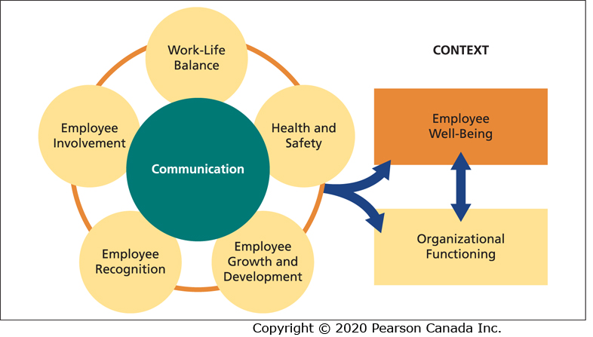
Essential Components of a Psychologically Healthy Workplace

Slide 36
Workplace Spirituality
Workplace spirituality refers to workplaces that provide employees with meaning, purpose, a sense of community, and a connection to others.
It is about providing employees with a meaningful work-life that is aligned with their values.
Employees have opportunities for personal growth and development, and they feel valued and supported.

Slide 37
Positive Organizational Behaviour (POB)
The study and application of positively oriented human resource strengths and psychological capacities that can be measured, developed, and effectively managed for performance improvement.
The psychological capacities that can be developed in employees are known as psychological capital or PsyCap.

Slide 38
Psychological Capital (PsyCap) (1 of 3)
An individual’s positive psychological state of development that is characterized by self-efficacy, optimism, hope, and resilience.

Slide 39
Self-Efficacy
One’s confidence to take on and put in the necessary effort to succeed at challenging tasks.

Slide 40
Optimism
Involves making internal attributions about positive events in the present and future and external attributions about negative events.

Slide 41
Hope
Persevering toward one’s goals, and when necessary making changes and using multiple pathways to achieve one’s goals.

Slide 42
Resilience
One’s ability to bounce back or rebound from adversity and setbacks to attain success.

Slide 43
Psychological Capital (PsyCap) (2 of 3)
Each of the components of PsyCap are states not traits; they are positive work-related psychological resources that can be changed, modified, and developed.
PsyCap is positively related to employee well-being, job attitudes, and job performance, and negatively related to employee anxiety, stress, and turnover intentions.

Slide 44
Psychological Capital (PsyCap) (3 of 3)
PsyCap interventions (PCI) can be used to develop employees’ PsyCap.
Organizations can improve employee health and well-being by developing employees’ PsyCap.

Slide 45
Talent Management and Employee Engagement (1 of 3)
Talent management refers to an organization’s processes for attracting, developing, retaining, and deploying people with the required skills to meet current and future business needs.
The management of talent has become a major organizational concern that requires the involvement of all levels of management.

Slide 46
Talent Management and Employee Engagement (2 of 3)
Work engagement refers to a positive work-related state of mind that is characterized by vigour, dedication, and absorption.
It has been reported that only one-third of workers are engaged.
Engaged workers have more positive job attitudes and higher job performance.
Employee engagement is considered to be key to an organization’s success and competitiveness.

Slide 47
Talent Management and Employee Engagement (3 of 3)
What does talent management and employee engagement have to do with organizational behaviour?
Organizational behaviour provides the means for organizations to be designed and managed in ways that optimize the attraction, development, retention, engagement, and performance of talent.

Slide 48
Corporate Social Responsibility (1 of 3)
Corporate social responsibility (CSR) refers to an organization taking responsibility for the impact of its decisions and actions on its stakeholders.
It extends beyond the interests of shareholders to the interests and needs of employees and the community in which it operates.
External CSR: Practices aimed at the local community, the environment, and consumers.
Internal CSR: Practices and activities that are focused on the internal workforce.

Slide 49
Corporate Social Responsibility (2 of 3)
What does a focus on social responsibility have to do with organizational behaviour?
Many CSR issues have to do with organizational behaviour (e.g., treatment of employees, work-family balance, employee well-being).
CSR also involves environmental, social, and governance (ESG) issues, and a concern for the environment and green initiatives.

Slide 50
Corporate Social Responsibility (3 of 3)
An organization’s CSR activities and policies are associated with financial performance as well as employee attitudes, engagement, and performance.
CSR also has implications for the recruitment and retention of employees.
Organizational behaviour can help organizations become more socially responsible.

Slide 51
Summary and Road Map (1 of 2)
Organizational behaviour involves three levels of analysis: the individual level (Part Two), the group level (Part Three), and the organizational level (Part Four).
The factors within each level influence individual and group attitudes and behaviours.
Each level can influence the factors and processes at the other levels.

Slide 52
Summary and Road Map (2 of 2)
All three levels of organizational behaviour as well as individual and group attitudes and behaviours influence organizational performance.

Slide 53
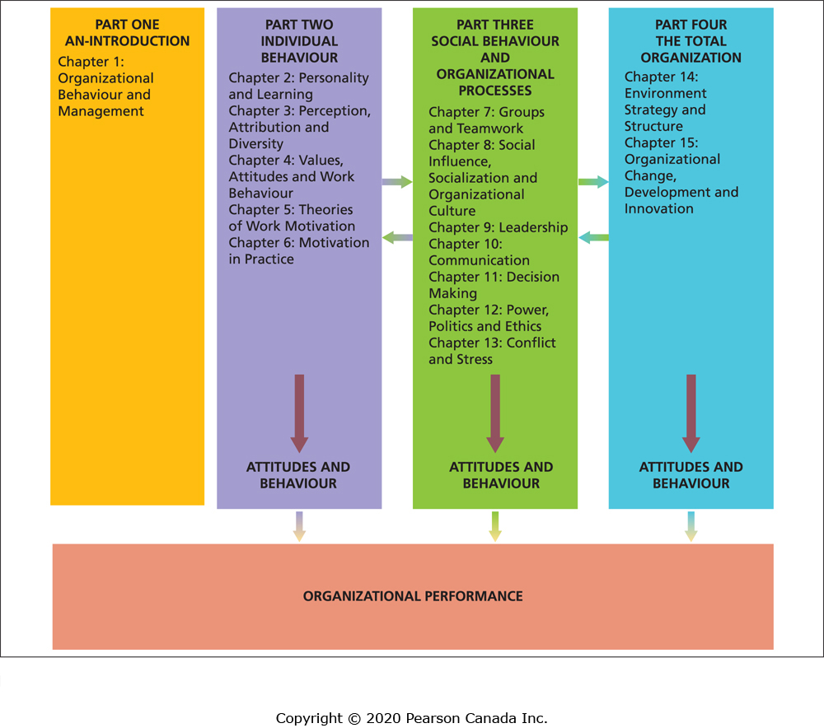
Model of Organizational Behaviour

